Slide 1
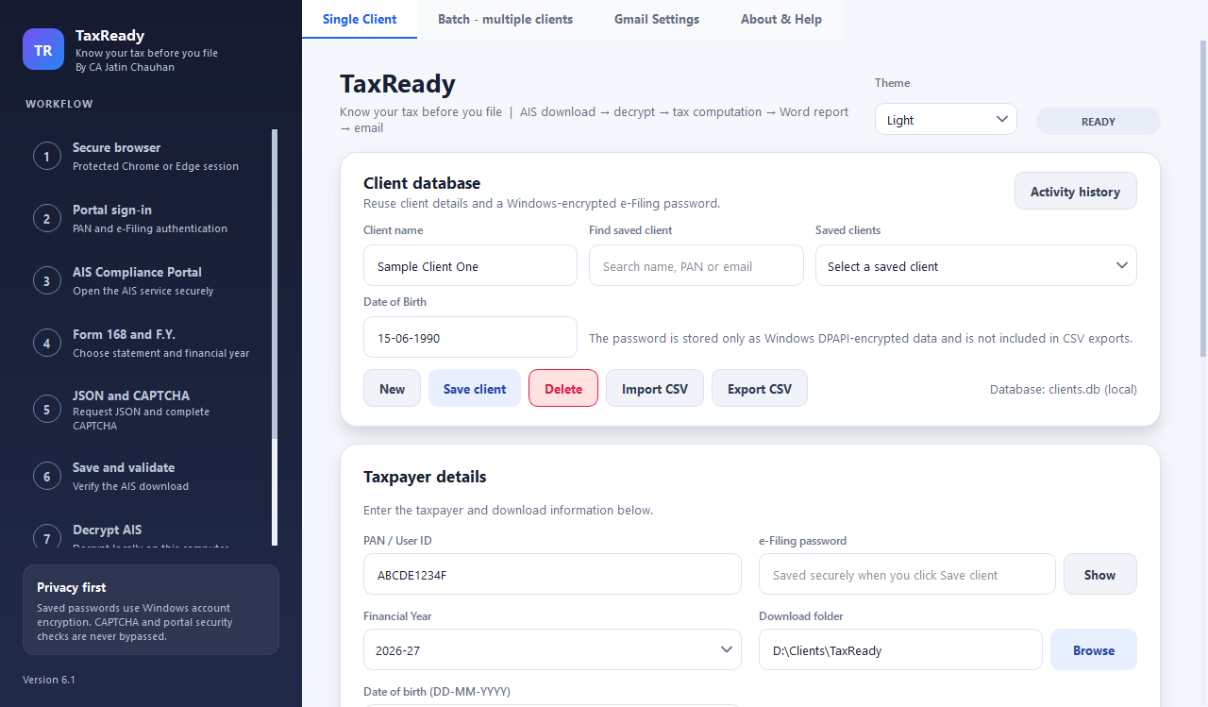
TaxReady
TAX PLANNING TOOL
Know your tax before you file
From AIS download to a client-ready tax estimate
By CA Jatin Chauhan
AICA Level 2 Batch 106
Notes:
Introduce TaxReady: it turns the client's AIS into an early tax estimate so the client can plan the payment.

Slide 2
Problem statement
Clients are not prepared for the tax amount payment
1
2
3
Tax due is a surprise
No time to arrange funds
Last-minute pressure
The amount payable becomes known only when the return is being prepared, close to filing.
The client has very little time to organise the money for the payment.
Payment is made in a rush, with stress for the client and extra follow-up for the CA.
TaxReady | Know your tax before you file | By CA Jatin Chauhan | AICA Level 2 Batch 106
2
Notes:
Clients usually learn the tax amount only at filing time, so they have no time to arrange the money.

Slide 3
Objective
Make the client ready for tax payment
Give the client time to arrange funds
Share a clear, early estimate of the tax payable
Advance notice means no last-minute scramble
How the tool gets there
AIS data
Tax estimate
Client informed
Funds arranged
Tax paid on time
TaxReady | Know your tax before you file | By CA Jatin Chauhan | AICA Level 2 Batch 106
3
Notes:
Two goals: make the client ready for the payment and give time to arrange funds. The tool delivers an early estimate.

Slide 4
How TaxReady works
1
2
3
4
5
Download AIS
Decrypt
Compute tax
Review
Email client
Signs in to the Income Tax portal in Chrome or Edge; you complete the CAPTCHA
Opens the AIS on your own computer using PAN and date of birth
Income, capital gains and deductions; old and new regime compared
Check and edit the figures before anything is sent (optional)
The Word report goes to the client with the key figures
Only the Word report is kept. The downloaded and the decrypted AIS files are deleted automatically.
TaxReady | Know your tax before you file | By CA Jatin Chauhan | AICA Level 2 Batch 106
4
Notes:
Walk through the five steps. The only manual action is the CAPTCHA on the portal.

Slide 5
TaxReady features
01
02
03
Automatic AIS download
Local decryption
Tax computation
Portal sign-in and download in Chrome or Edge; the CAPTCHA is always completed by you
The AIS is opened on your computer; nothing is sent to any other website
Old and new regime, rebate, surcharge, cess and taxes already paid
04
05
06
Capital gains
Word report
Email to the client
Sale value less purchase cost for every sale; missing costs are flagged
A client-ready review with the key figures and points to check
A designed Gmail message with the key figures; the report is attached
TaxReady | Know your tax before you file | By CA Jatin Chauhan | AICA Level 2 Batch 106
5
Notes:
Core features: download, local decryption, tax computation, capital gains with purchase cost, Word report, email.

Slide 6
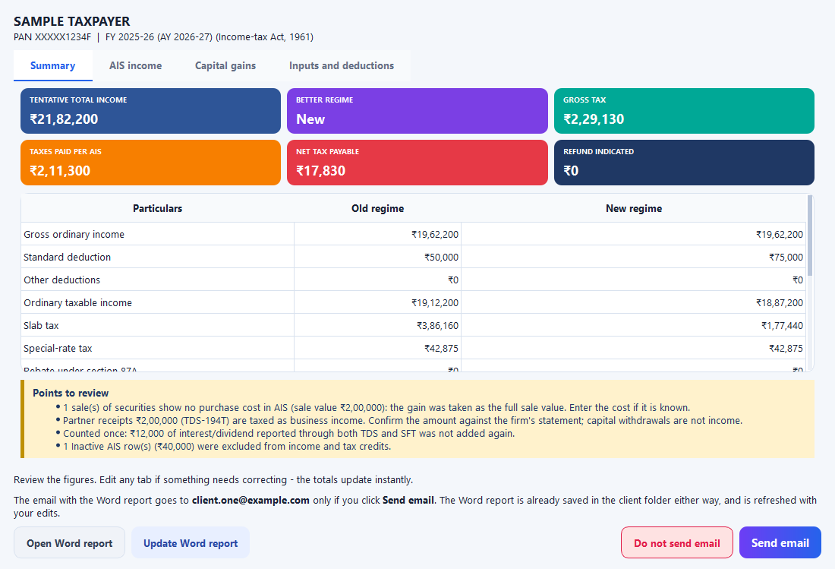
Control, speed and safety
Review and edit
Change classifications, add purchase costs, deductions, house property or business income; totals update instantly
Batch run
Tick many clients; the tool downloads, computes and emails them one after another
Client register
Saved clients, CSV import and an activity history that can be cleared
Secure by design
Passwords use Windows encryption; data stays on the computer
Themes and built-in help
Review and edit window (sample data)
Nine colour themes, an About & Help tab and a full user manual
TaxReady | Know your tax before you file | By CA Jatin Chauhan | AICA Level 2 Batch 106
6
Notes:
Review and edit, batch run, client register, security, themes. The screenshot uses sample data.

Slide 7
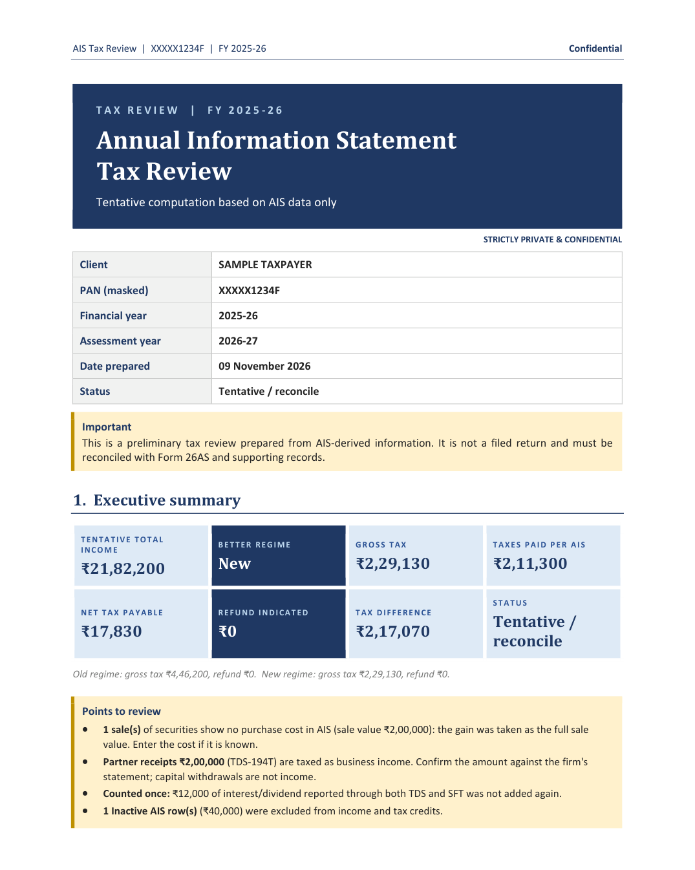
What the client receives
1
Tentative total income and tax under both regimes
2
Taxes already paid, as per the AIS
3
Net tax payable or refund, known in advance
4
Points to review, flagged clearly
Result: the client knows the amount early and has time to arrange funds
Estimate from AIS data only; not tax advice. Verify before filing.
TaxReady | Know your tax before you file | By CA Jatin Chauhan | AICA Level 2 Batch 106
7
Notes:
The client gets the Word report and an email with the key figures, early enough to arrange the payment.

